Slide 1
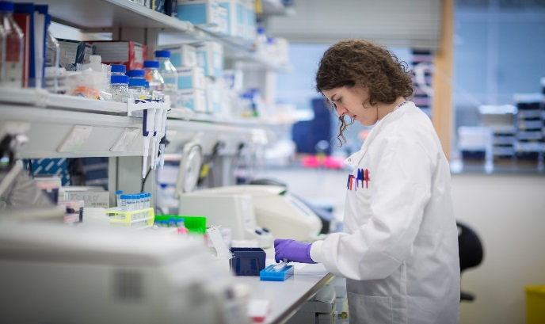
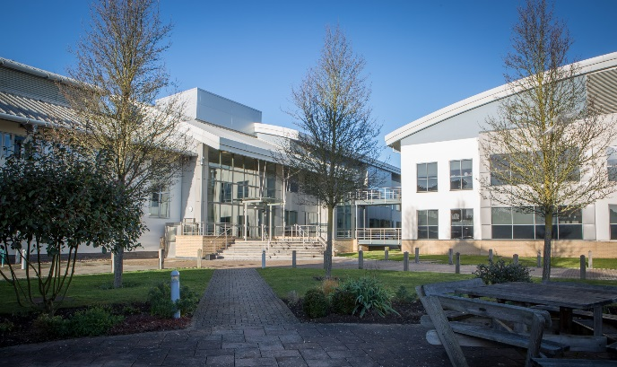
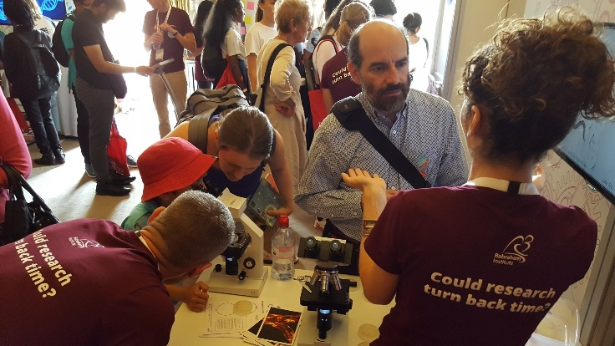
Autophagy: Recycling inside cells
@babrahaminst

Slide 2
Introduction to autophagy
Our cells have an in-built surveillance system called autophagy (which means ‘self-eating’ in Greek!)
Autophagy allows cells to detect and destroy bad proteins and bacteria that have entered the cell.
When cells don’t have enough food they also use autophagy to eat a bit of themselves to stay alive.
Even cells know that recycling is good!

Slide 3
Learning Outcomes
All students will: | Be able to define and describe the process of autophagy
Most students will: | Explain why it is important that our cells can undergo autophagy
Some students will: | Explain how scientists can study autophagy, giving an example
Key word/s | cell, autophagy, recycling, proteins,

Slide 4
Why do we need autophagy?
Autophagy keeps our cells healthy and us alive!
Increasing autophagy in cells can make some animals live longer and help combat infections
Sometimes too much can be bad for cells
Scientists are trying to understand how autophagy is turned on and off in the cell

Slide 5
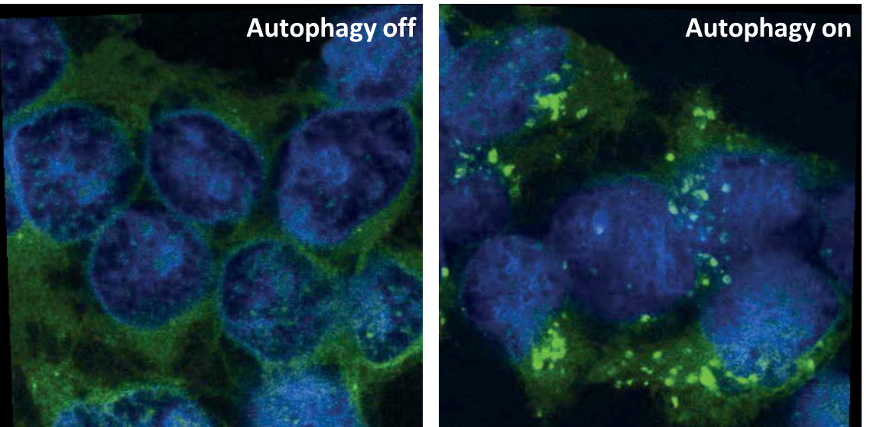
How can we study autophagy?
We can use special microscopes to see autophagy
DNA is shown in blue, and autophagy machinery in green
When we turn on autophagy, we can see lots of green dots
Notes:
Questions – how many cells can you count?

Slide 6
How can we study autophagy?
This picture shows a cell using autophagy (in green) to eat and destroy bad proteins (in red)
See how the autophagy spot is right on top of the bad protein (yellow)

Slide 7
Activity: The Autophagy Game
In this online game you take on the role of autophagy.
Protect the cell from:
Make sure you don’t accidentally eat and destroy healthy parts of the cell!
Access the online game here
Notes:
Game URL - https://www.babraham.ac.uk/autophagy-game/

Slide 8
Activity: The Autophagy Game
Follow the instructions and try to recycle as fast as you can in 1 minute!
Remember:
You get points if you find the damaged proteins and mitochondria that need to be recycled.
Click to remove them.
But don’t recycle the healthy proteins and mitochondria, otherwise you will lose points!
For extra points watch out for invading bacteria!
Remember your cells do this all day long to keep you healthy

Slide 9
Plenary
How good were you at autophagy? What was your score?
Name three things in a cell that autophagy eats.
Why do our cells need autophagy?
How can scientists study autophagy?

