Slide 1
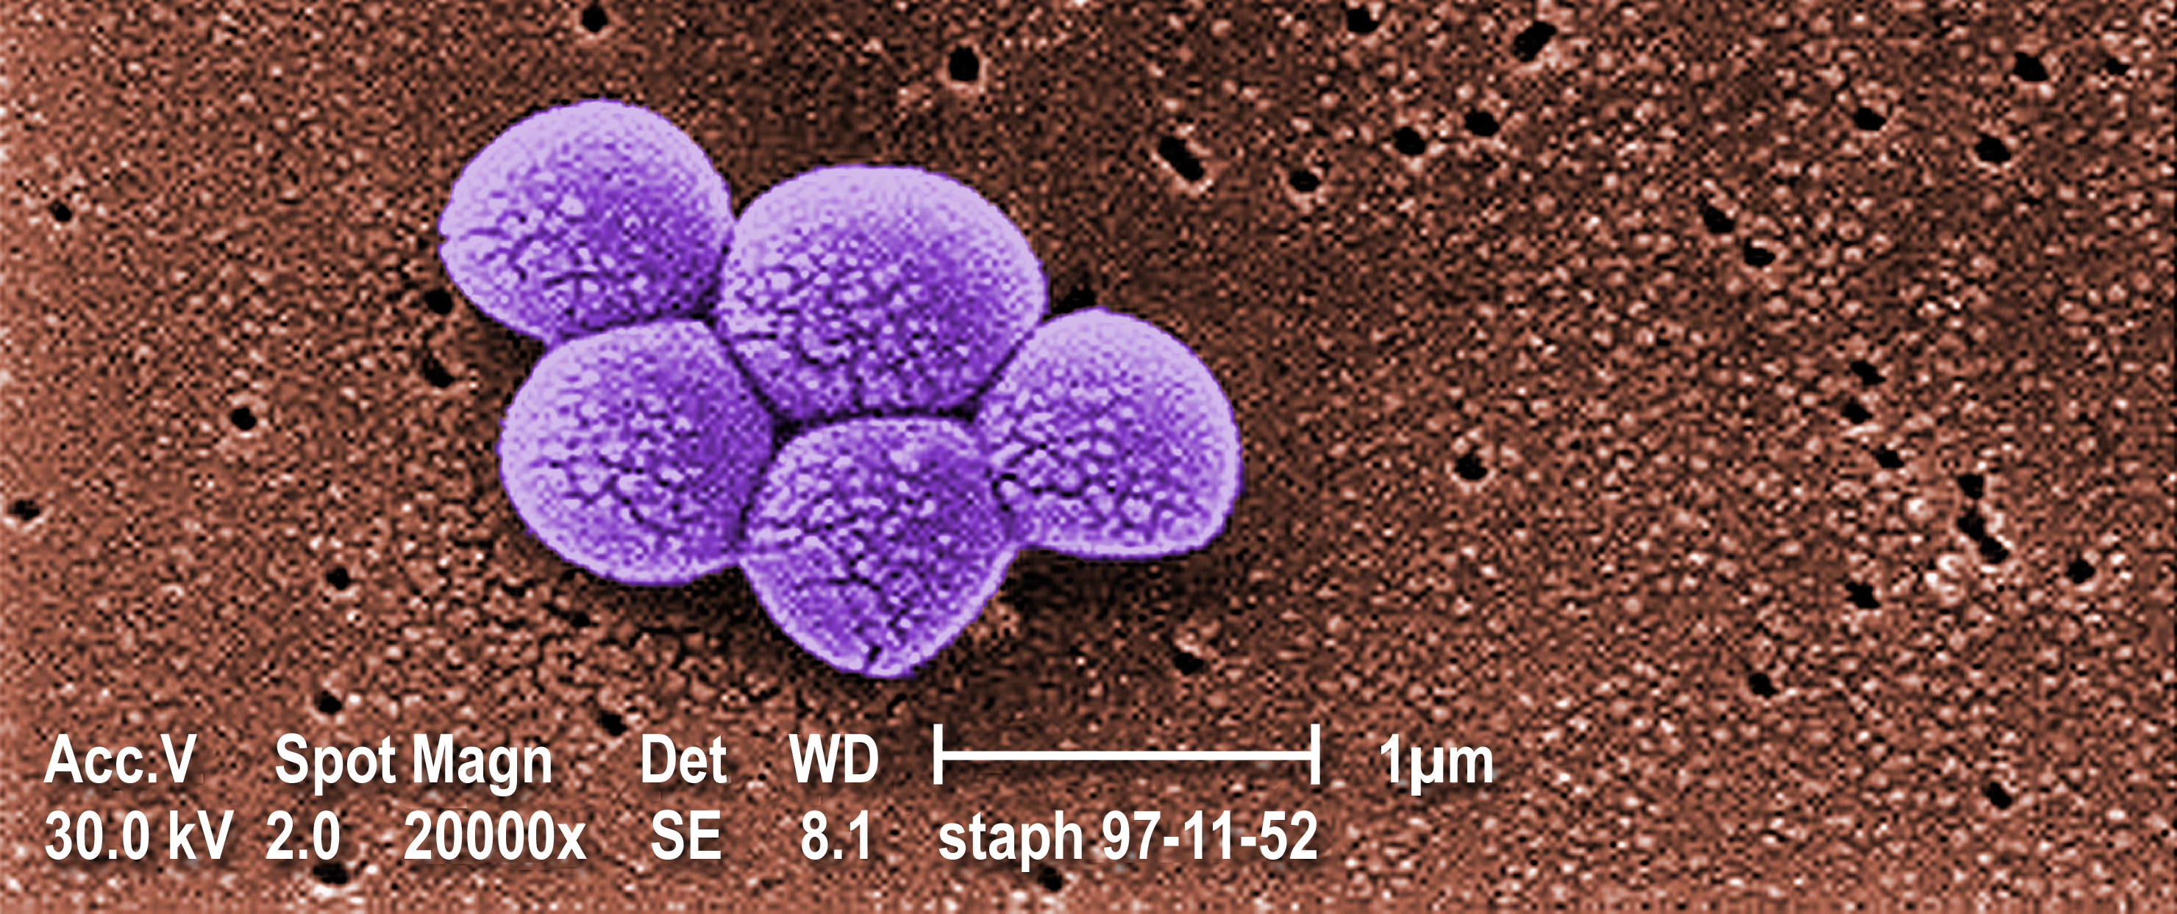
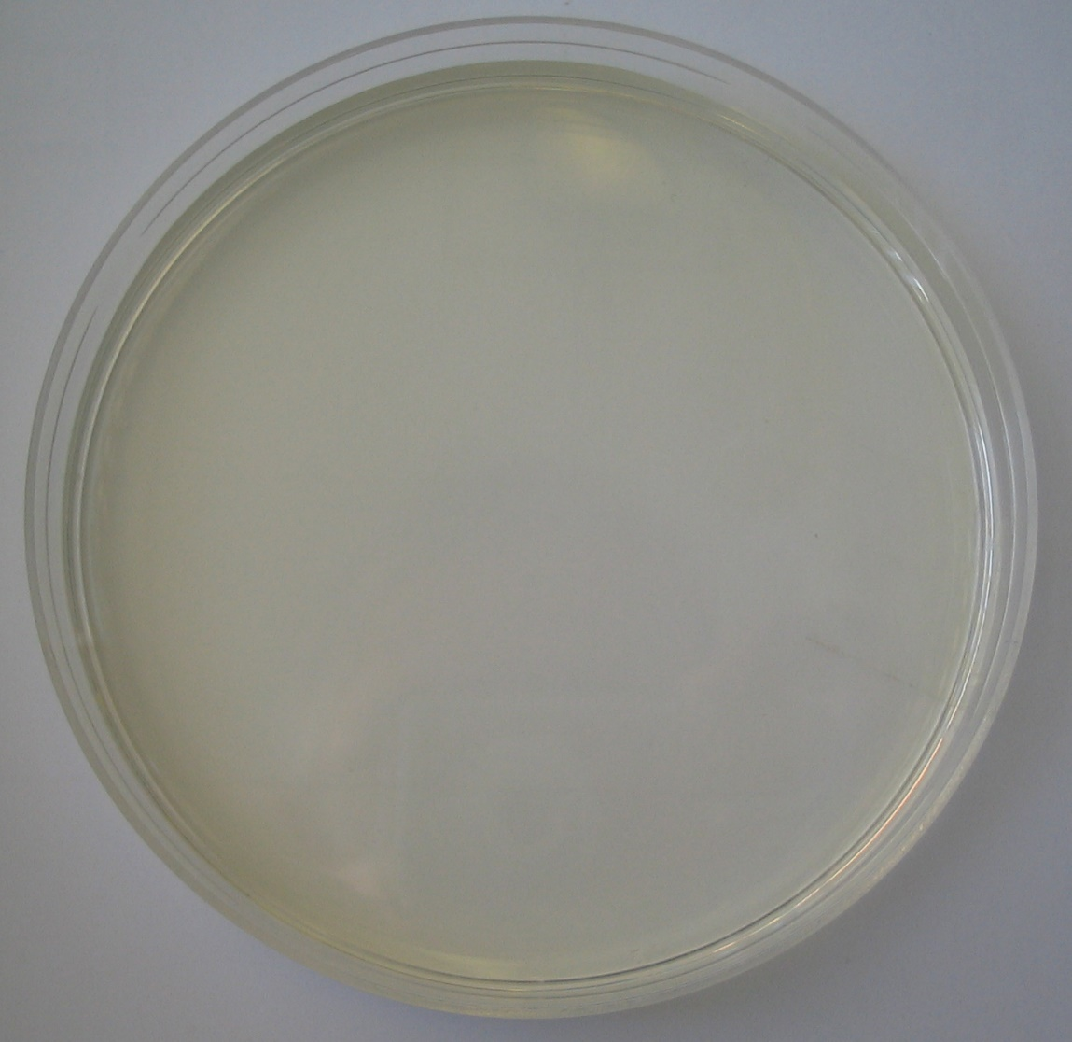
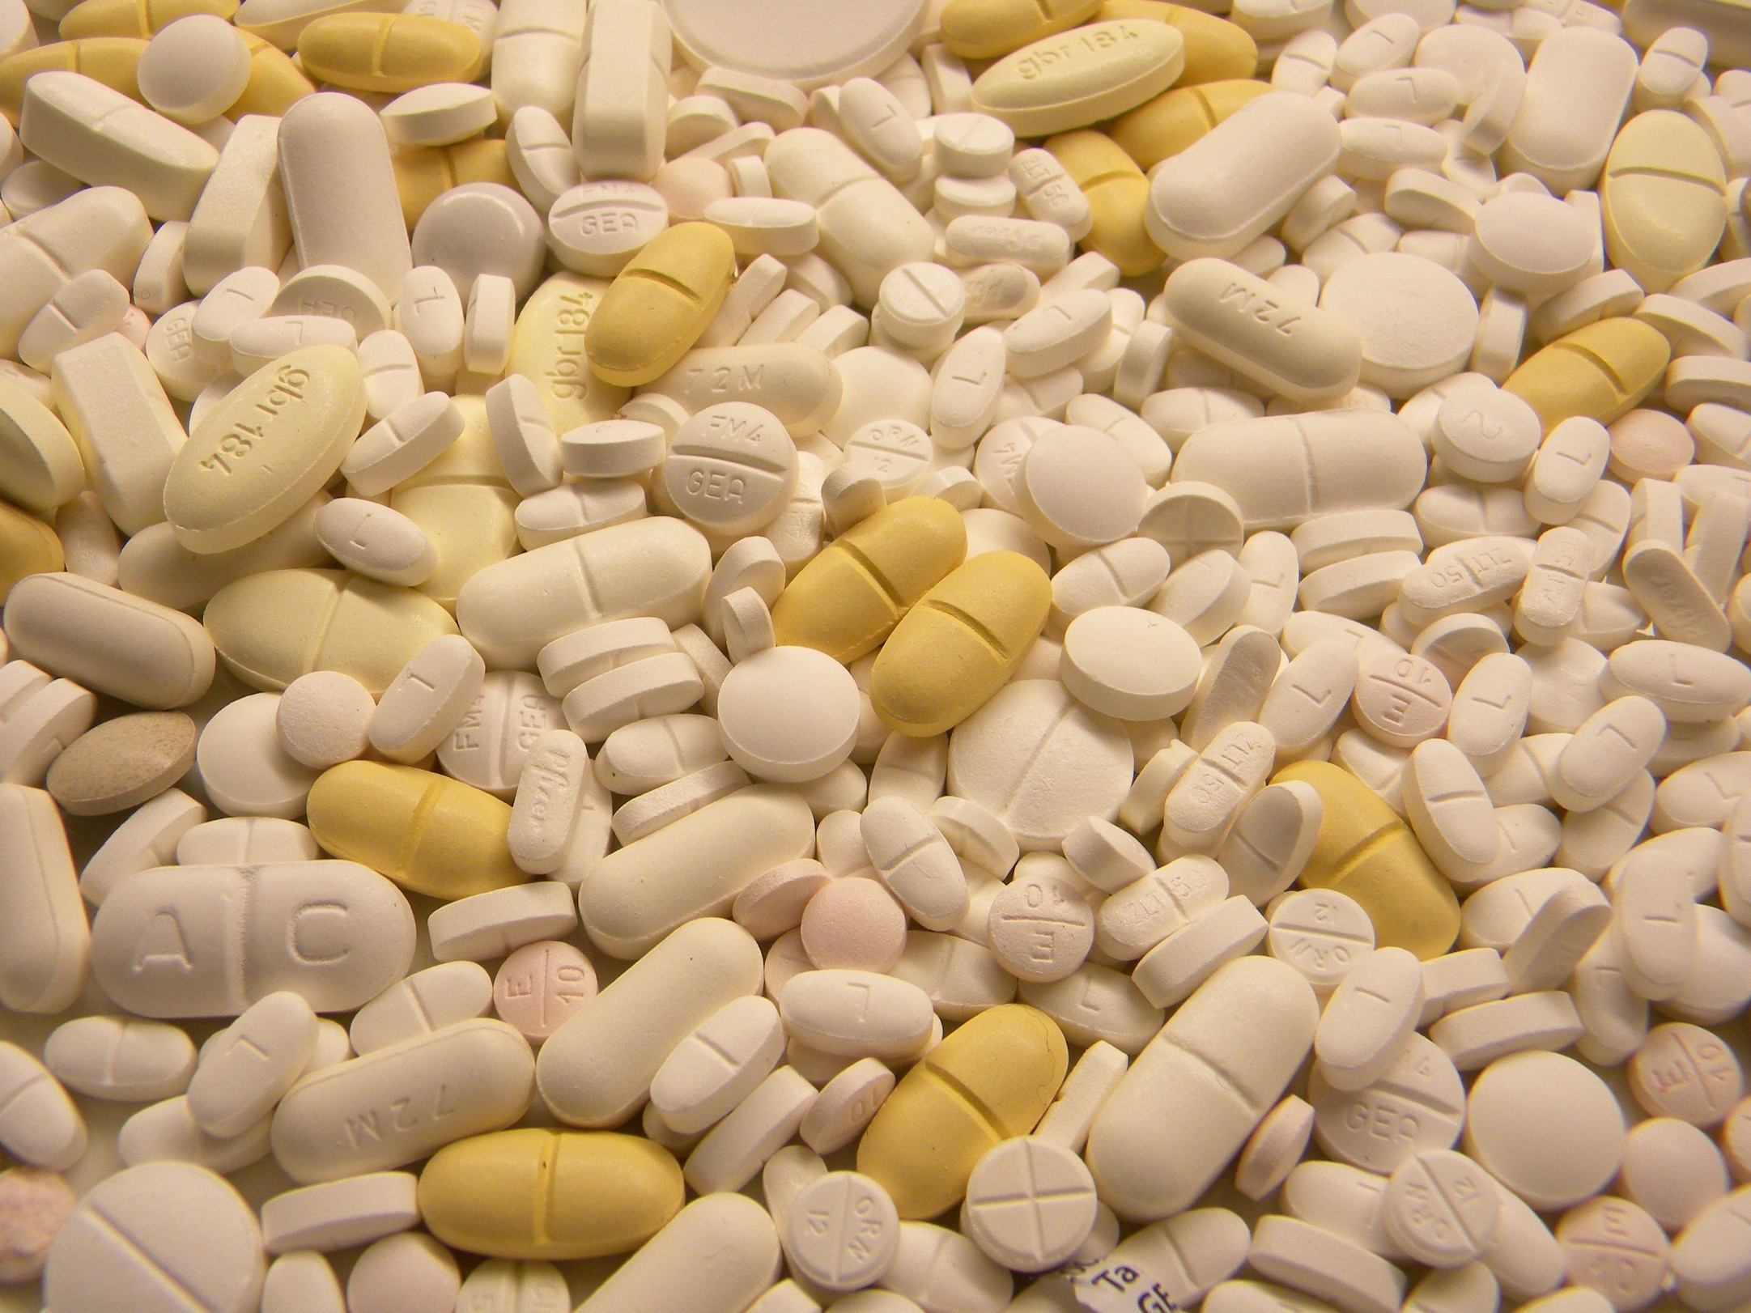
“Wellsoon” is a new antibiotic for treating MRSA
Cassandra Hogan, Helen Craig, Mike Hinton & Hakim Yadi
Introduction
Method
We grew MRSA bacteria on nutrient medium in petri dishes.
We dipped small circles of filter paper into different drugs and put them on top of the bacteria in the dish. If the drug is killing the bacteria, there will be a clear ring around the paper circle where the bacteria are dead.
We measured the diameter of this ring in millimeters with a ruler. We tested each drug 3 times.
When one of the many processes happening in the body goes wrong, or when the body is infected with bacteria or viruses, we feel ill or are in pain.
Medicines can kill organisms that cause infection, or can alter processes in the body such that we get better. Antibiotics are medicines that kill bacteria that are infecting the body.
MRSA is an illness that causes people to become very ill as there are very few drugs that can be used to treat it.
We tested five potential new drugs (medicines) to see which is the most effective against MRSA
MRSA
Filter paper circle soaked in drug
Ring of dead bacteria
Results
Conclusion
Drug name | Diameter of white circle (mm)
 | Dish #1 | Dish #2 | Dish #3 | Average
Magic cure | 12 | 22 | 23 | 19
Supadrug | 24 | 22 | 26 | 24
Wellsoon | 14 | 13 | 12 | 39
Megacillin | 20 | 22 | 18 | 20
Bacteristop | 30 | 30 | 27 | 29
The five different drugs tested all have different effects on the growth of MRSA. “Wellsoon” was the best at killing MRSA bacteria.
Future work will now be carried out to investigate why “Wellsoon” is so effective at killing MRSA, and whether or not it would be suitable for use in humans
Average diameter of white circle (mm)
Notes:
1

