Slide 1
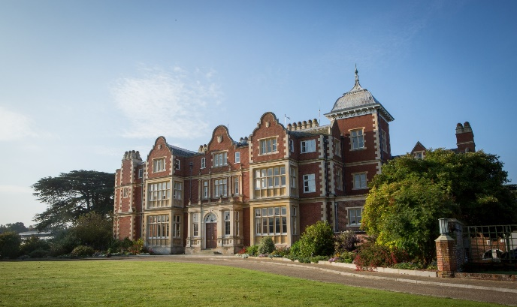
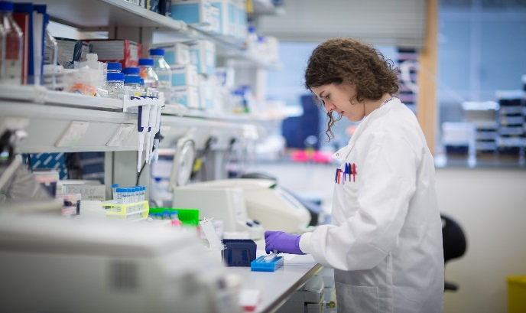
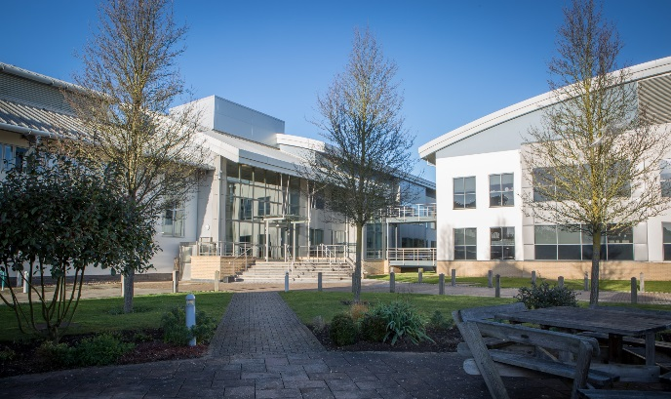
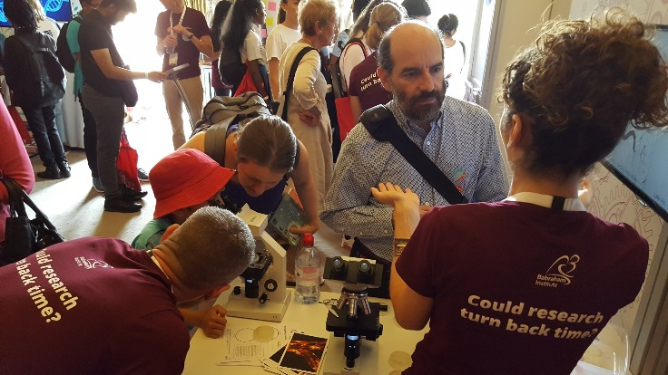
Peer Review: How scientists get their homework marked
@babrahaminst

Slide 2
Learning Outcomes
All students will: | Measure/record experimental data and draw a conclusion from a drawn graph
Most students will: | Be able to explain the concept of peer review
Some students will: | Explain why reports of scientific developments in the popular media are not subject to peer review and may be oversimplified, inaccurate or biased.
Key words | Peer, publication, journal, hypothesis

Slide 3
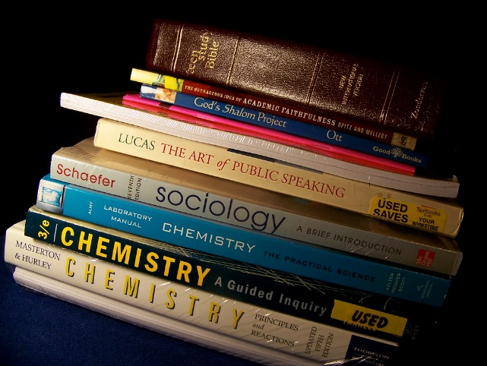
How does science make it into school?
Eventually we have a good idea of what is happening, and the science ends up in text books
Lots of experiments are done, until there is enough data to prove a hypothesis
The experiments are written up and published in a journal.
Notes:
Explain how science works - defining a problem, making a hypothesis, doing experiments to prove this. Then you write it up as a paper in a journal. Lots of people around the world will be working on the same thing, and lots of papers will get published about slightly different aspects of the problem – they won’t all agree with each other. Over time the evidence builds up and we get a better picture of what is going on. Eventually the picture is clear enough for the science to be put in a text book, though there may still be unanswered questions.

Slide 4
How do we write up experiments?
You
Us
Prediction
Method
Results
Conclusion
Marked by teacher
}
Hypothesis
Method
Results
Conclusion
?
Background reading and research
Notes:
Run this as a Q and A with the class – scribble what they come up with on the blackboard. Point out the similarities and try and get them to ask how research can be ‘marked’ if it’s completely new…

Slide 5
What is the difference?
If our research findings have never been published before, how can we be sure that:
Our experiments were run correctly
Our data is correct
Our conclusions are valid
We use the PEER REVIEW process
Notes:
Could approach this by asking the class what they would do if they had to get their homework right but there was no teacher to check it – bring them round to the idea that they would ask each other, and this is basically what peer review is.

Slide 6
What is peer review?
Who are your peers?
People who are in similar circumstances to you - in your case other people of the same age and level of schooling. In scientific research, your peers are other scientists who may be in the same research area.
Before a paper is published it is sent to other researchers in the same area of science
They have to agree that the experiments and conclusions are valid for it to be published.
Notes:
Talk through the bullet points and ask the students (in groups) to come up with their ideas on what a reviewer might look for

Slide 7
Your turn!
Imagine you are important scientists
A world-famous journal has sent you a scientific paper to review.
They would like your comments on the paper, and they would like to know whether you think it should be published or not.
Notes:
Give the publication out to the class and get them to look at it in groups. Ask them to read the intro and methods and make sure everyone in their group understands. Discuss the results – make sure everyone knows what an average is and that you don’t include anomalous results when calculating the average. Then get the class to work in groups looking for any errors/problems with the paper, particularly in the results section, and also ask them to think of comments on the paper as a whole.

Slide 8
Some questions…
Does the fact that a drug is good at killing bacteria mean it will be a good treatment for humans?
What would you do if you were given this paper to review and you had just made a similar discovery that you knew would:
make you famous for finding a cure
earn you lots of money by selling the rights to a pharmaceutical company
Notes:
These are optional open-ended extension activities for group and/or class discussions.

Slide 9
So what have we learned?
Scientists do experiments, write up their results as a paper and submit it to a journal.
The paper then gets checked by a process called Peer Review.
Reviewers (scientists in the same field) check for errors, and that the research is ‘good’ science.

